Slide 2
Bad USB presentation Disclaimer
https://www.linkedin.com/company/wocsa/ https://www.youtube.com/@WOCSA-rx2mn/
Disclaimer
The following demonstration is for educational purposes only.
We do not promote or encourage illegal activities.
Knowing your enemy is a half-won battle
La connaissance n'est réellement profitable que lorsqu'elle est partagée
https://github.com/wocsa

Slide 3
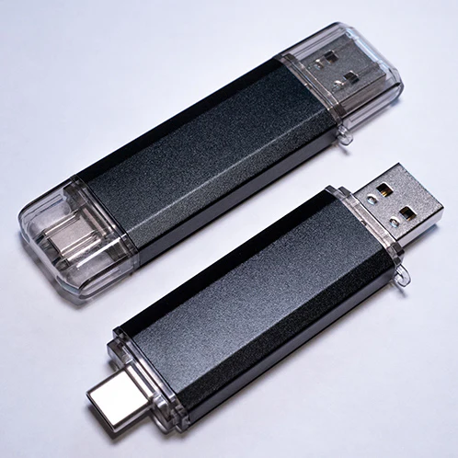
What is Bad USB?
https://www.linkedin.com/company/wocsa/ https://www.youtube.com/@WOCSA-rx2mn/
Like a normal USB key
When plugged in, performs predefined action
Can be the source of a compromise if not monitored closely
PlugX malware was distributed in a campaign through badUSBs
Malduino, from Maltronics
https://github.com/wocsa

Slide 4
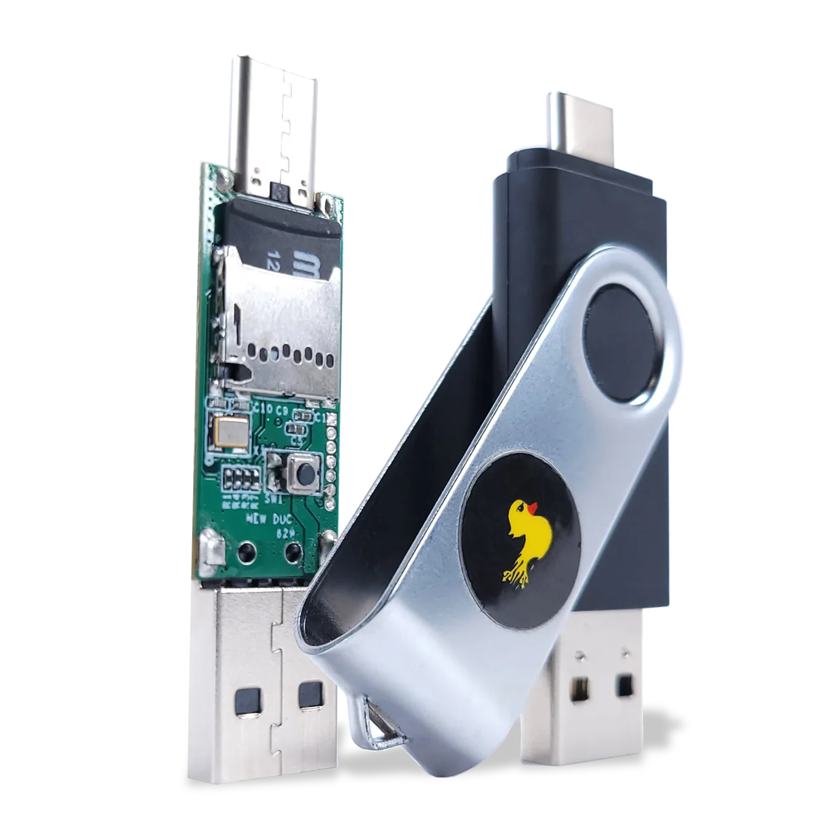
Why does it work?
https://www.linkedin.com/company/wocsa/ https://www.youtube.com/@WOCSA-rx2mn/
Peripherals announce their type when connected
The computer has no choice but to trust them
In cybersecurity, hardware and the human factor are the MOST VULNERABLE parts.
Combining them, a user plugging an USB key is a deadly method
Rubber ducky
https://github.com/wocsa

Slide 5





How it’s being exploited
https://www.linkedin.com/company/wocsa/ https://www.youtube.com/@WOCSA-rx2mn/
Which peripheral should the badUSB pretend to be?
https://github.com/wocsa

Slide 6
How it’s being exploited
https://www.linkedin.com/company/wocsa/ https://www.youtube.com/@WOCSA-rx2mn/
A keyboard enables it to send keystrokes to the computer!
https://github.com/wocsa

Slide 7

The human factor
https://www.linkedin.com/company/wocsa/ https://www.youtube.com/@WOCSA-rx2mn/
As this attack is hardware-based, a human needs to perform the attack, and another has to make a mistake
The victim can leave the computer unlocked
The attacker can perform social engineering to make the victim plug the computer
https://github.com/wocsa

Slide 8
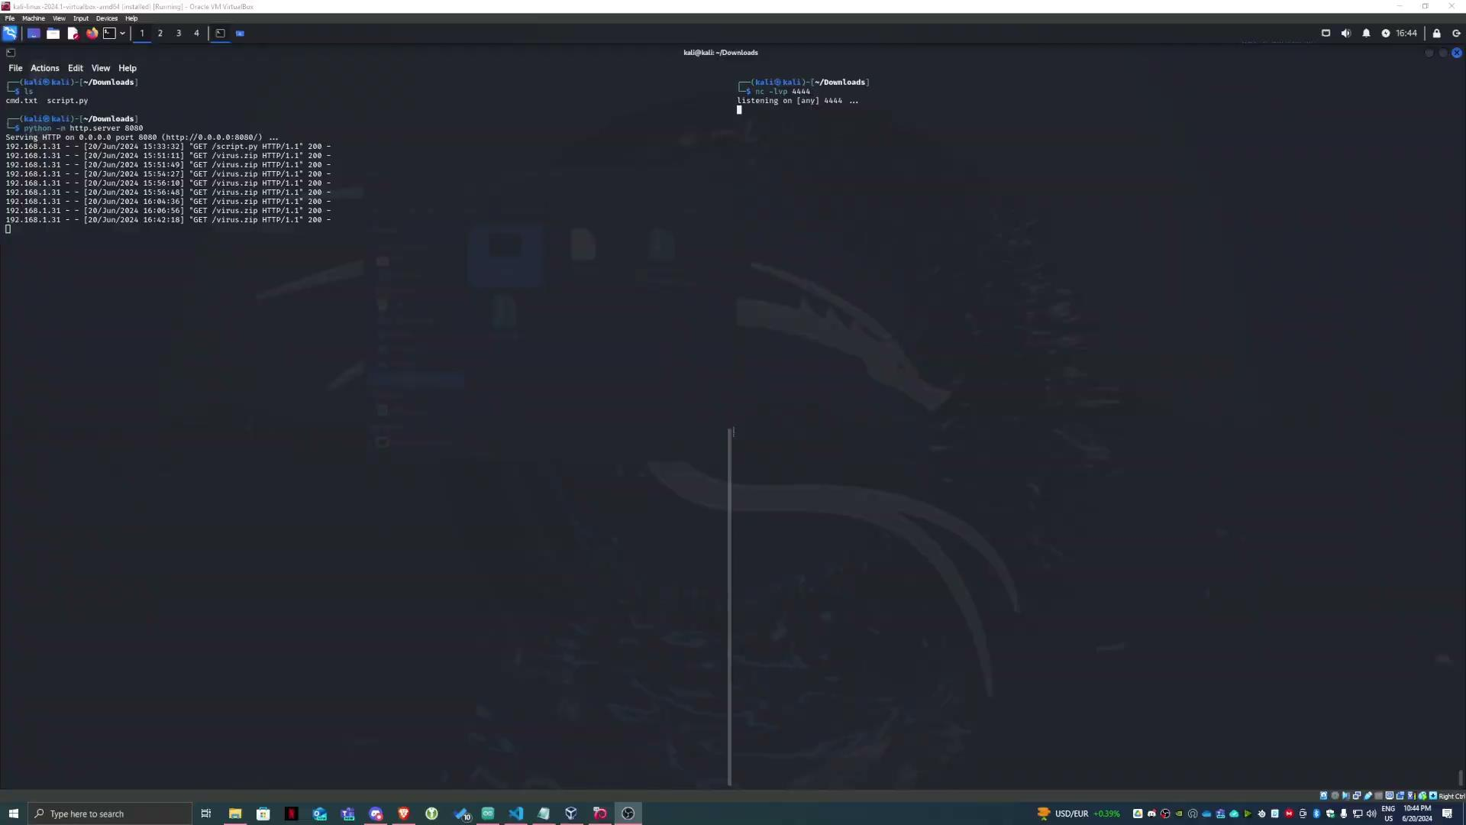
Example 1
https://www.linkedin.com/company/wocsa/ https://www.youtube.com/@WOCSA-rx2mn/
https://github.com/wocsa

Slide 9
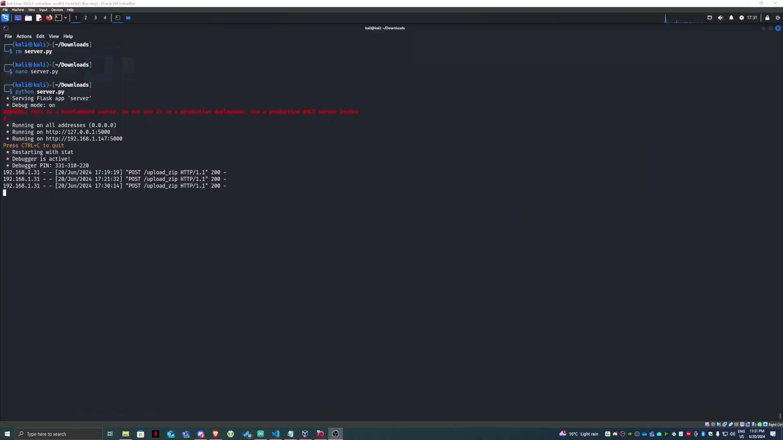
Example 2
https://www.linkedin.com/company/wocsa/ https://www.youtube.com/@WOCSA-rx2mn/
https://github.com/wocsa

Slide 10
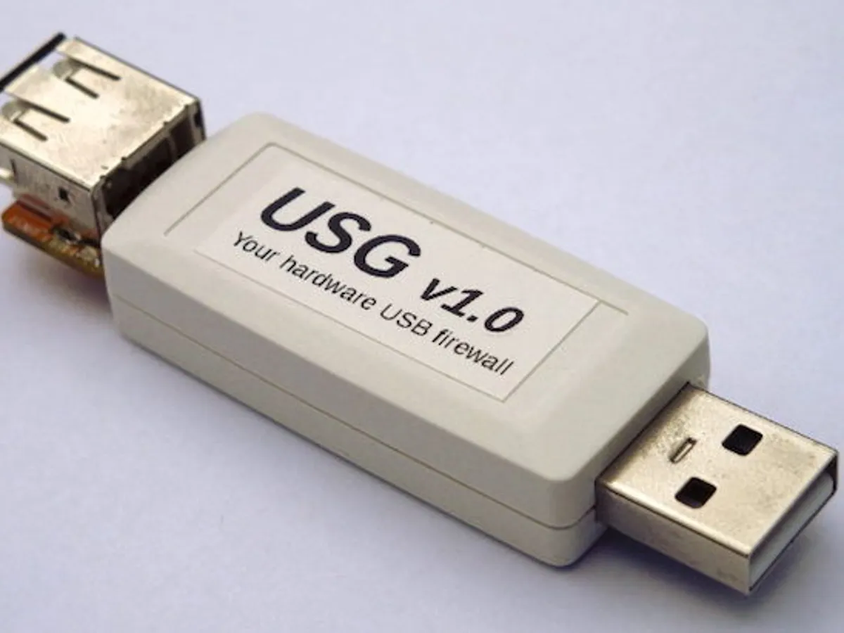
How to protect ourselves
https://www.linkedin.com/company/wocsa/ https://www.youtube.com/@WOCSA-rx2mn/
Never plug an untrusted USB key
Lock your computer when you need to leave it for some time
You can use an “USB condom” or plug untrusted devices on an isolated machine first to check its behavior
https://github.com/wocsa

Slide 11










Join us to change the digital world: https://www.helloasso.com/associations/wocsa/adhesions/bulletin-d-adhesion-2 Please provide your feedback for our quality check process: https://www.wocsa.org/qcheck.php
www.wocsa.org
@wocsa
@wocsa_asso
@wocsa
contact@wocsa.org
Join Us!
@WOCSA-rx2mn
https://discord.gg/pDunje3tpb

